Slide 2
Welcome!
Agenda
What is the Title VI of the Civil Rights Act?
LeeTran’s Title VI Plan Update
Title VI Notice and Compliant Procedures
Demographic Analysis
Language Assistance Plan and Outreach
Standards and Policies

Slide 3
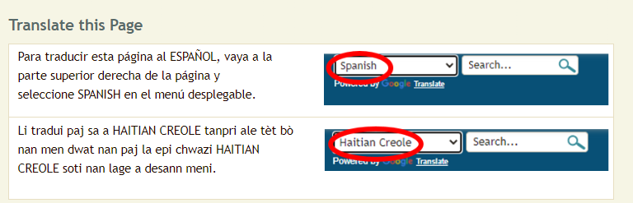
Para Español
Tres Opciones
Hablar conmigo después de la presentación
Llamar 727.328.4299
Página web: https://www.leegov.com/leetran/compliance

Slide 4
About the Public Meeting
This public meeting is being conducted in a hybrid format, offered in-person and virtual:
In-Person Location:
LeeTran Headquarters (3401 Metro Parkway, Ft. Myers, FL 33901)
Virtual Meeting:
Microsoft Teams
Hybrid Meeting
In-Person
Virtual

Slide 5
Title VI of the Civil Rights Act of 1964
Title VI of the Civil Rights Act of 1964, 42 U.S.C. 2000d et seq. prohibits discrimination on the basis of race, color, or national origin in any program or activity that receives Federal funds or other Federal financial assistance.

Slide 6
LeeTran Title VI 2023 - 2026 Update
Title VI Program is required by the Federal Transit Administration (FTA) to be updated every three years.
Developed and updated to ensure no person, on the grounds of race, color, or national origin, is excluded from participating in, denied the benefits of, or subjected to discrimination.
Last Update was completed September 2020

Slide 7
Title VI Notice to the Public
Title 49 CFR Section 21.9(d) requires recipients to provide information to the public regarding the recipient’s obligations under DOT’s Title VI regulations and apprise members of the public of the protections against discrimination afforded to them by Title VI.

Slide 8
Title VI Notice to the Public
Title VI Notice to Public Posted Locations:
LeeTran Administrative Office
Bus Terminals
LeeTran Website: https://www.leegov.com/leetran/compliance
Available Languages
English - Located Here
Spanish - Located Here
Haitian-Creole - Located Here

Slide 9
Title VI Complaint Procedures and Form
In order to comply with the reporting requirements established in 49 CFR Section 21.9(b), all recipients shall develop procedures for investigating and tracking Title VI complaints filed against them and make their procedures for filing a complaint available to members of the public.

Slide 10
Title VI Complaint Procedures and Form
Required to be posted on LeeTran’s website:
https://www.leegov.com/leetran/compliance
Available Languages:
English – Located Here
Spanish – Located Here
Haitian-Creole – Located Here

Slide 11
Active Title VI Investigations, Complaints, and Lawsuits
LeeTran is required to keep record of any public transportation-related Title VI investigations, complaints, or lawsuits.
There have been no Title VI investigations, complaints, or lawsuits filed with LeeTran since the adoption of the previous Title VI Plan (September 2020).

Slide 12
Meaningful Access to Limited English Proficiency (LEP) Populations
Four Factor Analysis - Used to determine the specific language services that are appropriate to provide.
Four Factor Analysis Process
The Nature and Importance of the Program, Activity or Service Provided by Program
Resources Available to Recipient for LEP Outreach and Costs Associated with that Outreach
Number or Proportion of LEP Persons Eligible to be Served or Likely to be Encountered
Frequency With Which LEP Persons Come Into Contact With Program

Slide 13
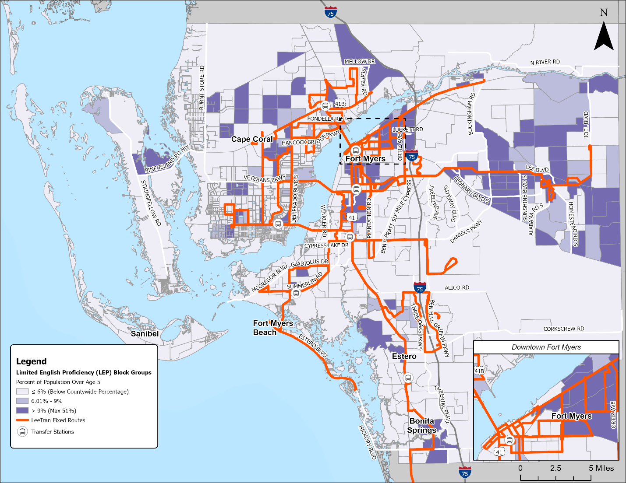
Meaningful Access to Limited English Proficiency (LEP) Populations Continued
Total Lee County Population*: 718,115
Estimated LEP Population: 69,811
Percent LEP Population of Total Lee County Population*: 9.72%
Top Three LEP Groups in Lee County:
Spanish
French/Haitian/Cajun
*Population 5 Years and Older

Slide 14
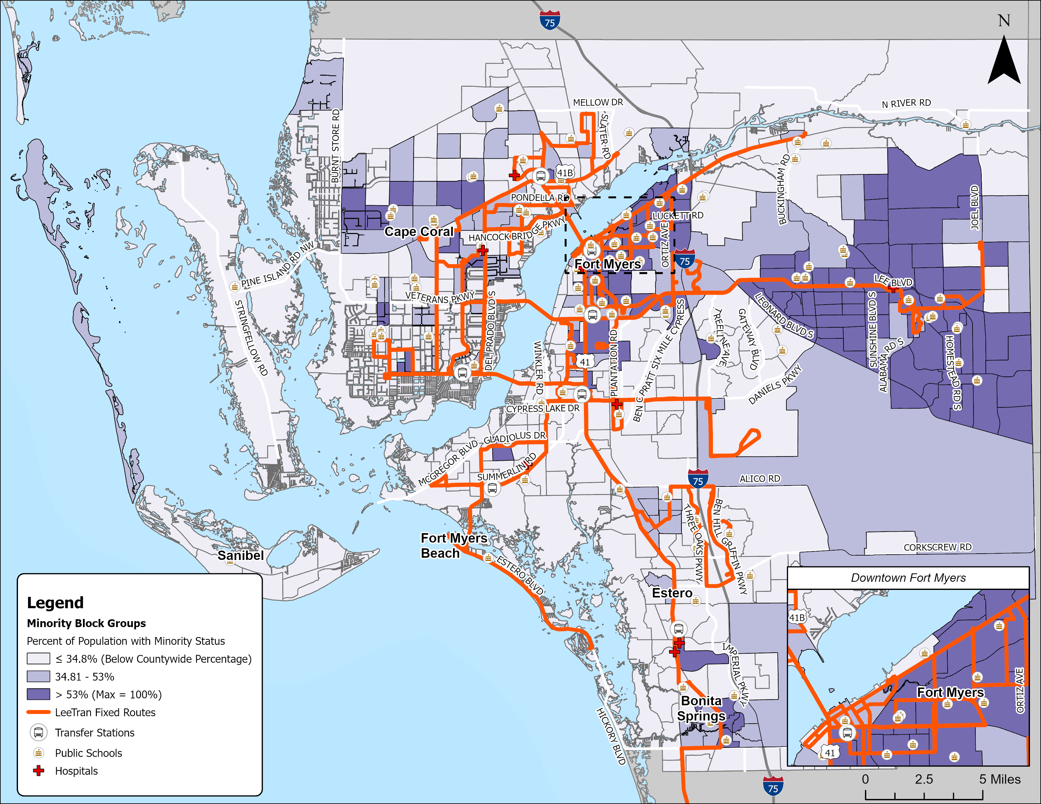
Demographic Analysis
Total Lee County Population: 752,251
Estimated Minority Population: 261,747
Percent Minority Population of Total Lee County Population: 34.8%

Slide 15
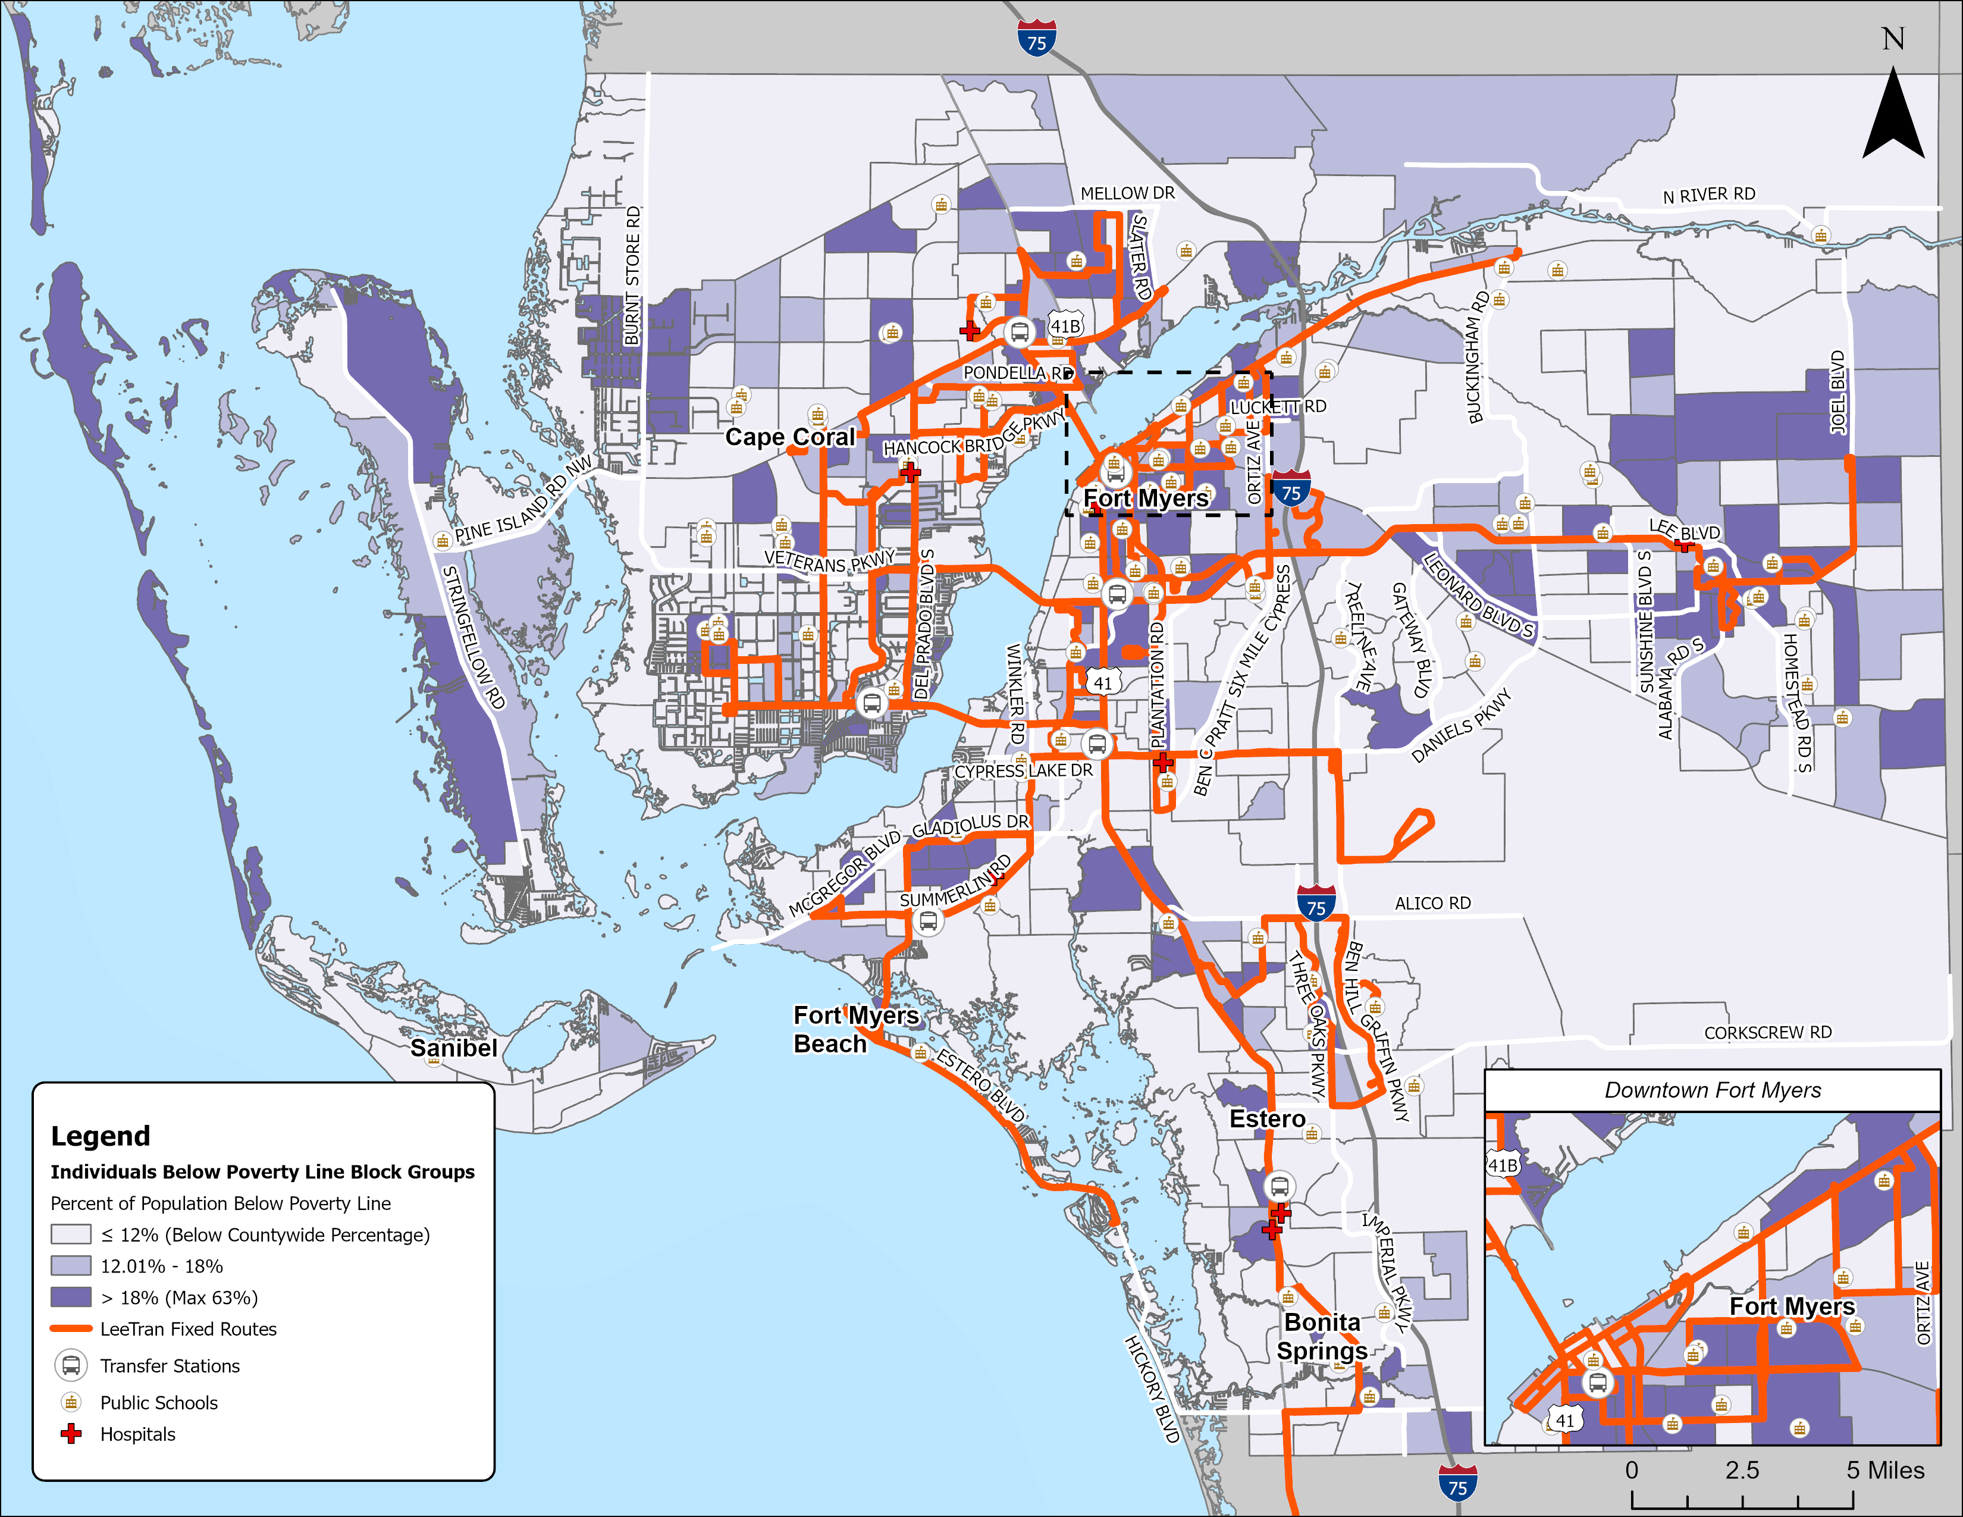
Demographic Analysis
Total Lee County Population: 718,115
Estimated Low-Income Population: 89,578
Percent Low-Income Population of Total Lee County Population: 12%

Slide 16
Language Assistance Plan and Outreach
Service Alerts
Website Translations
Translated Announcements and Documents
Customer Service
Community Outreach

Slide 17
Service Standards and Policies
Service Standards
Vehicle Load
Vehicle Headway
On-Time Performance
Service Availability
Service Policies
Transit Amenity Distribution by Mode
Vehicle Assignment by Mode

Slide 18
Major Service and Fare Policy Change
Major Service
Major service changes include the reduction of an entire route or the addition of a new route, as defined in Lee County’s Administrative Code 11-15. Total elimination of service on a specific route requires BOCC action and an announcement of a public hearing in the News-Press. New routes to provide service to an area with no existing mass transit requires BOCC approval. The following steps should be followed as part of any major service change:
Route changes identified under Administrative Code 11-15 will use said code for guidance.
Elimination of a route will require Title VI analysis of service impacts. The findings of this analysis will be provided to the BOCC through the County’s public hearing procedures.
In addition to the Administrative Code 11-15 requirements, LeeTran will complete the steps laid out in LeeTran Policy #900-01, included in Appendix C.

Slide 19
Next Steps
October 2023 - Finalize Title VI Program Report
November 2023 - Lee County Board of County Commissioner Approval
December 2023 - Submittal to Federal Transit Administration

Slide 20
Contact Information
Ranice E. Monroe, Ed. D.
Compliance Coordinator Lee County Transit – LeeTran
Ph: 239.533.0374
rmonroe@leegov.com
Corinn Beem, AICP
Project Manager
Kimley-Horn and Associates
Ph: 813.635.5503
Corinn.Beem@kimley-horn.com

